Slide 1
Twitter analytics using sap hana and sap lumira
By:
Mahesh Gottam
Chair:
Dr. Mohammad Abdus Salam
Committee Members:
Dr. Shizong Yang
Dr. Jose Noguera

Slide 2
AGENDA
INTRODUCTION
BIG DATA CONCEPTS
STATEMENT OF PROBLEM
RESEARCH QUESTIONS
OBJECTIVES
DELIMITATION
DESIGN
IMPLEMENTATION
TEXT ANALYSIS
FULL TEXT INDEX
CORE AND DOMAIN EXTRACTION
SENTIMENT ANALYSIS

Slide 3
BIG DATA DEFINITION(S)
The new tools helping us find relevant data and analyze its implications.
The broad range of new and massive data types that have appeared over the last decade or so.
The shift (for enterprises) from processing internal data to mining external data.
The convergence of enterprise and consumer IT
The belief that the more data you have the more insights and answers will rise automatically from the pool of ones and zeros.
The shift (for individuals) from consuming data to creating data.

Slide 4
90% of 500 world biggest companies have BIG DATA projects.
Retail
Industry
Finances
Healthcare
Sustainability
Security

Slide 5
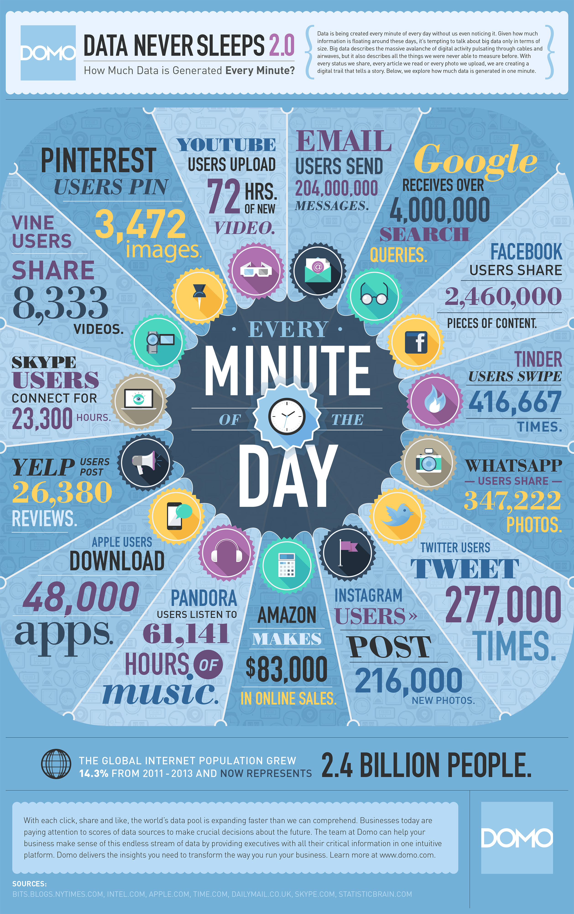

Slide 6
Statement of Problem:
To build up an application to perform Text Analysis and sustaining to cloud database like SAP Hana and after that performing the information representation utilizing SAP Predictive Analysis visually

Slide 7
RESEARCHH QUESTIONS
Which platform is needed and efficient to develop an application?
Is it necessary to add web services for login and registration of end users?
How to fetch the old data from the twitter if needed?
Can we fetch the data of local organization for Text Analysis?

Slide 8
OBJECTIVES
Main objective is to convert the unstructured data to structured data
Task is to store the ongoing information from social network (twitter) and this information is used for text analysis and also sentiment analysis and additionally perform Segmentation utilizing SAP HANA clustering and using SAP LUMIRA

Slide 9
Delimitations
We use a particular word to extract the tweets related to particular word.
Application is only for real time data feeds.
Every tweets cannot be retrieved at once and also the fetched data depends on the keyword we gave at the time of interacting with the Twitter API.

Slide 10
Involved Design:
Step1: We installed all the tools required
To perform text analysis we should install the SAP HANA studio and SAP Lumira with an username and password to the Workbench we are going to use to develop the application.
Step2: We have the Twitter Account
To interact with the Twitter API and to establish a connection with real-time data flowing through it we should have an account in that and should register as an app developer in that.
Step3: We shall develop an node.js application to establish connection between the database and the twitter.
The methods used will be developed based on the modules of the JavaScript application and server establishing techniques.

Slide 11
Continued…
Step4: To program the queries to extract the data from the twitter and load the data into the database.
We should write the queries to extract the useful data from the twitter and load that data to SAP HANA databases.
Step5: Loading data from the SAP Hana Database to SAP Predictive Analysis for Data Visualization
We shall connect the database to the SAP Predictive Analysis and load the data into it to perform the required analysis.

Slide 12



Architecture
Twitter
LUMIRA
HANA
API
DATA
EXPLORE
Hana Studio
JDBC
Tweet retriever
Tables / Views

Slide 13
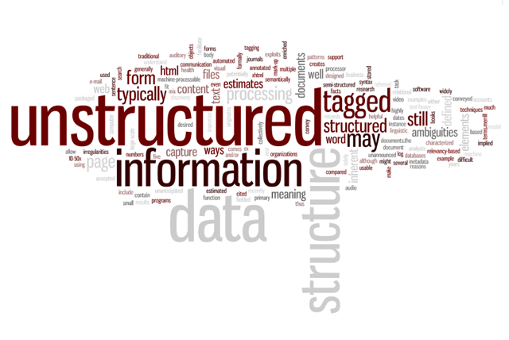
Implementation

Slide 14
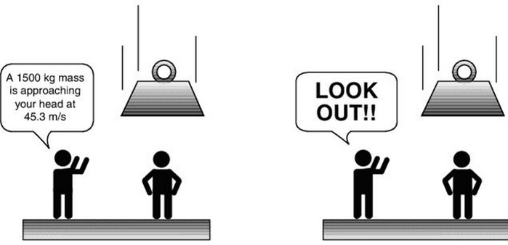
Structured
Unstructured

Slide 15
TEXT ANALYSIS
Enhance search based applications
Patents
Incidents
Healthcare Treatments
Drive decisions
Email interpretation
Documents, general text
Brand Monitoring
Extract meaningful information from raw data
Text Categorization
Segmentation
Tokenization

Slide 16
FULL TEXT INDEX
BASIC EXAMPLE
Prerequisite
In order to create a full-text index the data needs to be stored in a SAP HANA table
Goal
create a full-text index in order to run search on natural language data
CREATE FULLTEXT INDEX myIndexName ON myTable(myColumn);

Slide 17
CHARACTERISTICS
A full-text index is bound to a table column
Automatic update of full-text index on create, update, delete
Full-text index is dropped of table/column is dropped.
Processing steps
File filtering
Language detection
Tokenization
Stemming

Slide 18
CORE AND DOMAIN EXTRACTION
Text Analysis gives ‘structure’ to two sorts of elements from unstructured text:
Core entities
<PERSON>Bruce Dickison</PERSON> is the greatest singer of<ORGANIZATION@ENTERTAINMENT> Iron Maiden </ORGANIZATION@ENTERTAINMENT>
Domain Extraction
I <SENTIMENT>love</SENTIMENT> <TOPIC>your product</TOPIC>

Slide 19
HOW DOES IT WORKS?
It is not a keyword search
Full linguistic and statistical techniques
Natural Language Processing
Grammatical Parsing:
Can we bill you?
Bill was that president.
Semantic Disambiguation:
The duck has a bill.
The bill was signed into law

Slide 20
SUPPORTED ENTITY TYPES
Who
People, job tittle and national identification numbers.
What
Companies, organizations, financial indexes and products
When
Dates, days, holidays, months, years, and time periods
Where
Addresses, cities, states, countries, facilities, internet addresses and phone numbers
How much
Currencies and units of measure
Generic concepts
“Big Data”, “global piracy”, “global warming” and others..

Slide 21
HOW TO DO IT?
Text analysis is implemented with a FULL TEXT INDEX
A Configuration file is mandatory to perform TA.
CREATE FULLTEXT INDEX myIndexName ON myTable(myColumn)
CONFIGURATION configurationFileName
TEXT ANALYSIS ON;

Slide 22
CONFIGURING TEXT ANALYSIS
LINGANALYSIS_<X>
<X>:
BASIC – Tokenization
STEMS – + Stemming (dictionary based)
FULL – + Tagging (labeling words)
EXTRACTION_<X>
<X>:
CORE – Entities like people, organizations or places.
CORE_ENTERPRISE – management changes, acquisition, mergers…
CORE_PUBLIC_SECTOR – events, persons. Related to security
CORE_VOICEOFCUSTOMER – sentiments and requests.

Slide 23
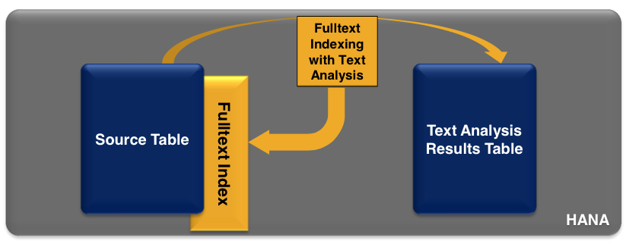
TEXT ANALYSIS RESULTS
Fulltext indexes are accessed indirectly (trough main table)
Text Analysis results are directly accessed in the $TA_<index_name>.
New data is automatically analyzed.

Slide 24
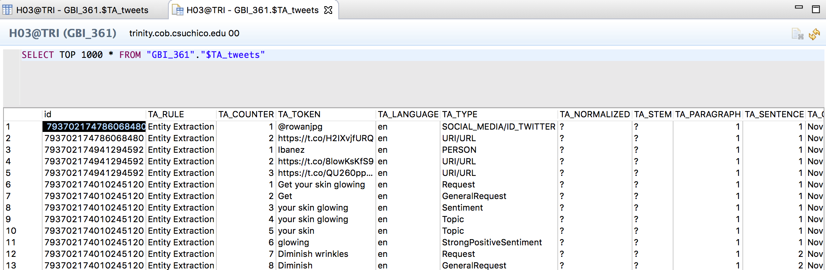
EXAMPLE

Slide 25
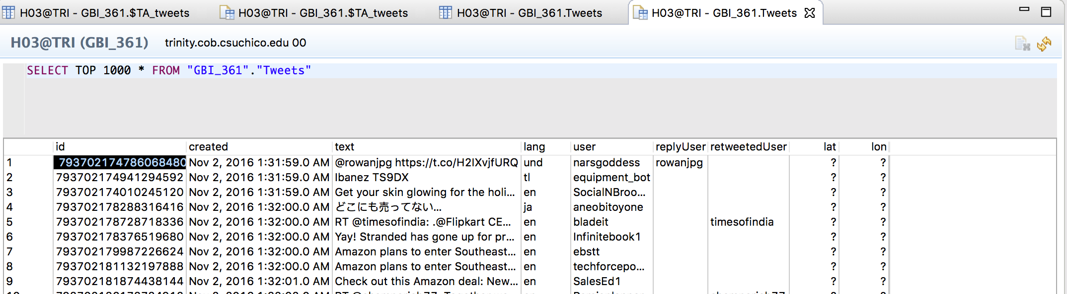
TWEETS TABLE

Slide 26
SENTIMENT ANALYSIS
CHARACTERISTICS
Domain extraction built on core configuration
Look for facts/relations/states among entities
Relations:
Mahesh read the book
States:
Mahesh birthday is on April 30th

Slide 27
Voice of customer(domain extraction)
Sentiments:
Positive, negative, neutral
Intensity: Strong/Weak
Requests
General and contact info
Emoticons
Positive :) and Negative :(
Intensity: Strong/Weak :D XD :(((
Profanity
Ambiguous and unambiguous
Languages: Chinese, Dutch, English, French, German, Italian, Portuguese, Russian

Slide 28
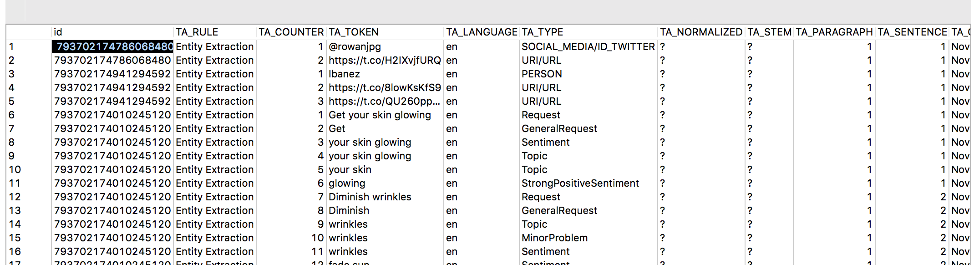
example
CREATE FULLTEXT INDEX "tweets" ON "Tweets"("text")
CONFIGURATION 'EXTRACTION_CORE_VOICEOFCUSTOMER’
LANGUAGE COLUMN "lang" LANGUAGE DETECTION ('EN','FR','DE','ES','ZH')
TEXT ANALYSIS ON;

Slide 29
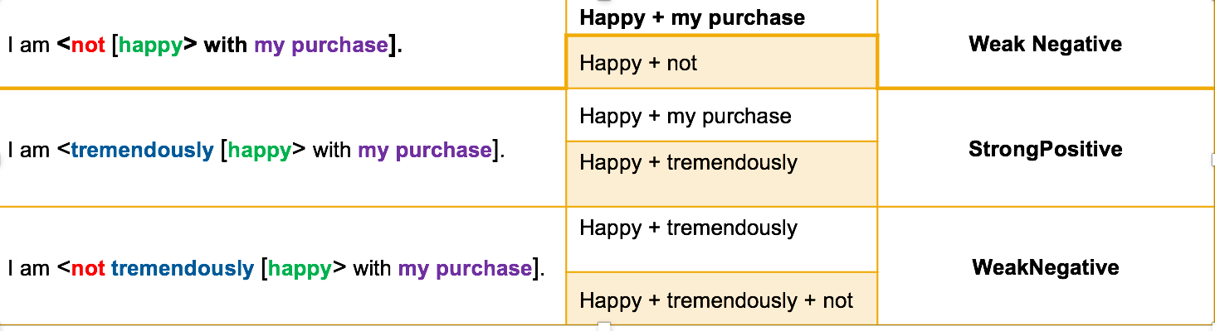
Sentiment rules
2 sets of rules are applied followed by a filter
1st set – Identifies positive/negative keywords topics
2nd set – Identifies positive/negative keywords along with intensifiers
Filter sorts through rules results and outputs one final value for each

Slide 30
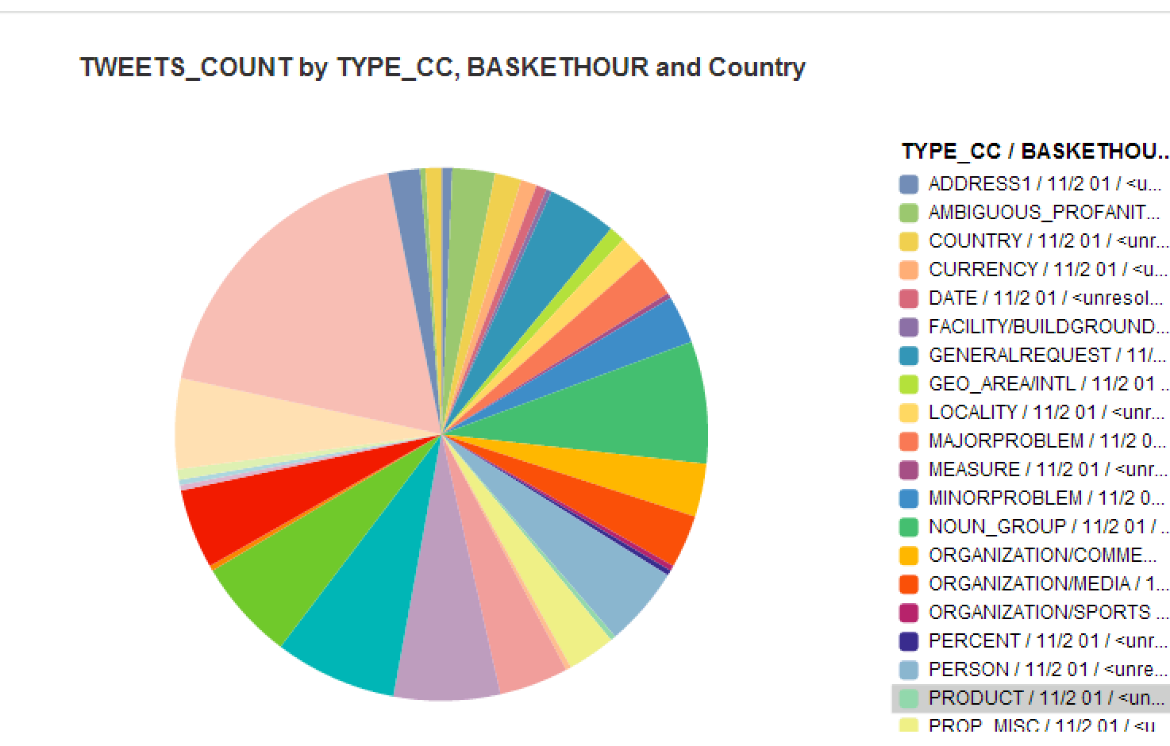
Twitter analysis

Slide 31
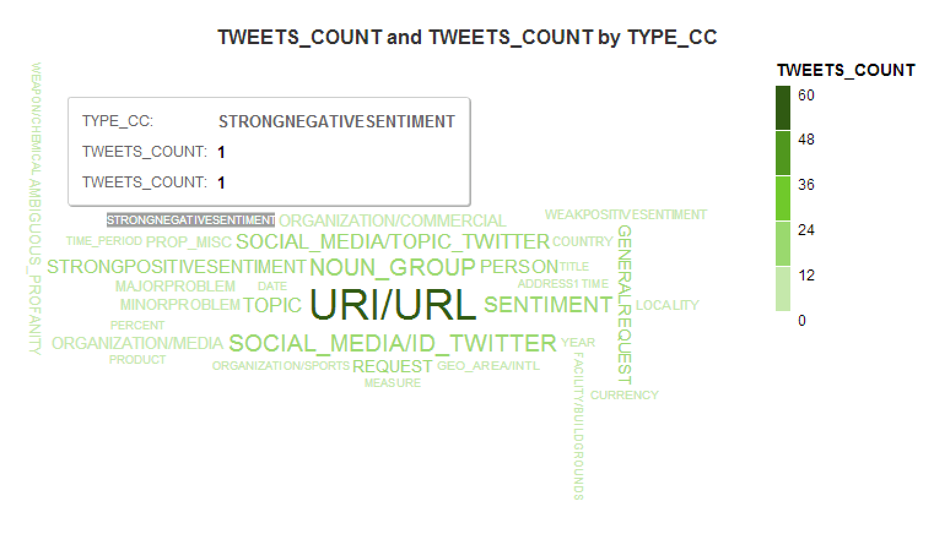

Slide 32
Conclusion
Analyzed the twitter data and generated the calculation views by taking the tweet counts and with different index types through the aggregation of time dimension and TA_tweets using SAP HANA.
We can see the data in a visual format which is easily understandable by using the SAP LUMIRA.

Slide 33
Future work
To facilitate the work we would like to develop a mobile application and web application for the organizations using OData services in SAP HANA.
We would like to improve the work by taking multiple keywords at a time such as considering AMAZON, TARGET, STARBUST and other organization and to perform sentiment analysis by the tweets from the twitter.

Slide 34
THANK YOU

